Slide 1
POINT OF SALES SYSTEM
Prepared by: Asma Abughaith

Slide 2


OUTLINES
Introduction
Problem
Objectives
Methodology
Result

Slide 3



INTODUCTION
Every business owner wants to know:
which product sells the most.
which customers buy frequently.
how much inventory is on hand, what method is preferred by customers when paying (cash, credit, checks or debit).
how much did seller Actually sell on a particular day.
A point of sale system is designed to provide this information to the business owner

Slide 4




PROBLEM
Inside King Abdullah Business Park, HTU opened a store. The HTU IMU hired me to create a Point of Sale (POS) web application to manage inventory and sales transactions. Numerous personnel in a variety of roles will work on the POS.

Slide 5



OBJECTIVE 1
1- Create a Point of Sale (POS) website that addresses the
challenges that HTU faces in managing the store at King Abdullah Business Park.
OBJECTIVES
OBJECTIVE 2
2- handle customer
transactions, as well as track sales and inventory.
OBJECTIVE 3
3-Providing the administrator with real-time information about the
store'soperations.

Slide 6


Tools and software used:
METHODOLOGY
1 FRONT-END HTML, CSS, Bootstrap, JavaScript , jQuery
1 FRONT-END PHP, MySQL, Xampp Serve

Slide 7
02
Create the development environment
Steps of project production:
01
Plan the POS system's functionality.
03
Create the database
05
Create the views
04
Create the models
06
Implement the controllers

Slide 8
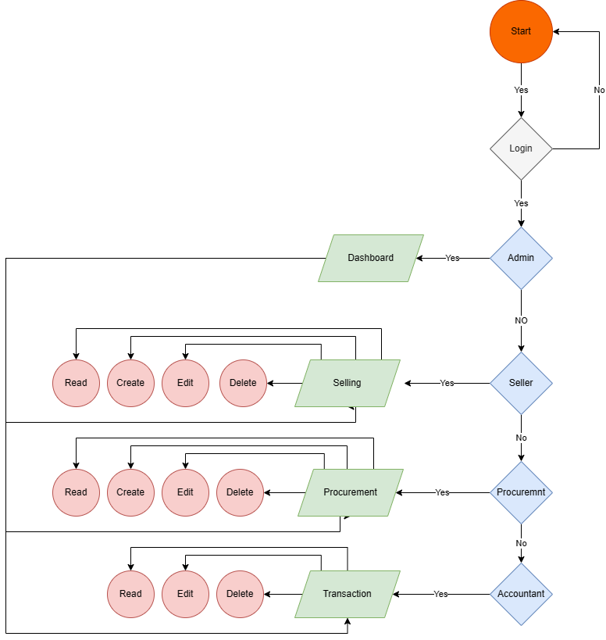
FLOW WORK

Slide 9



THANK YOU

